Slide 1

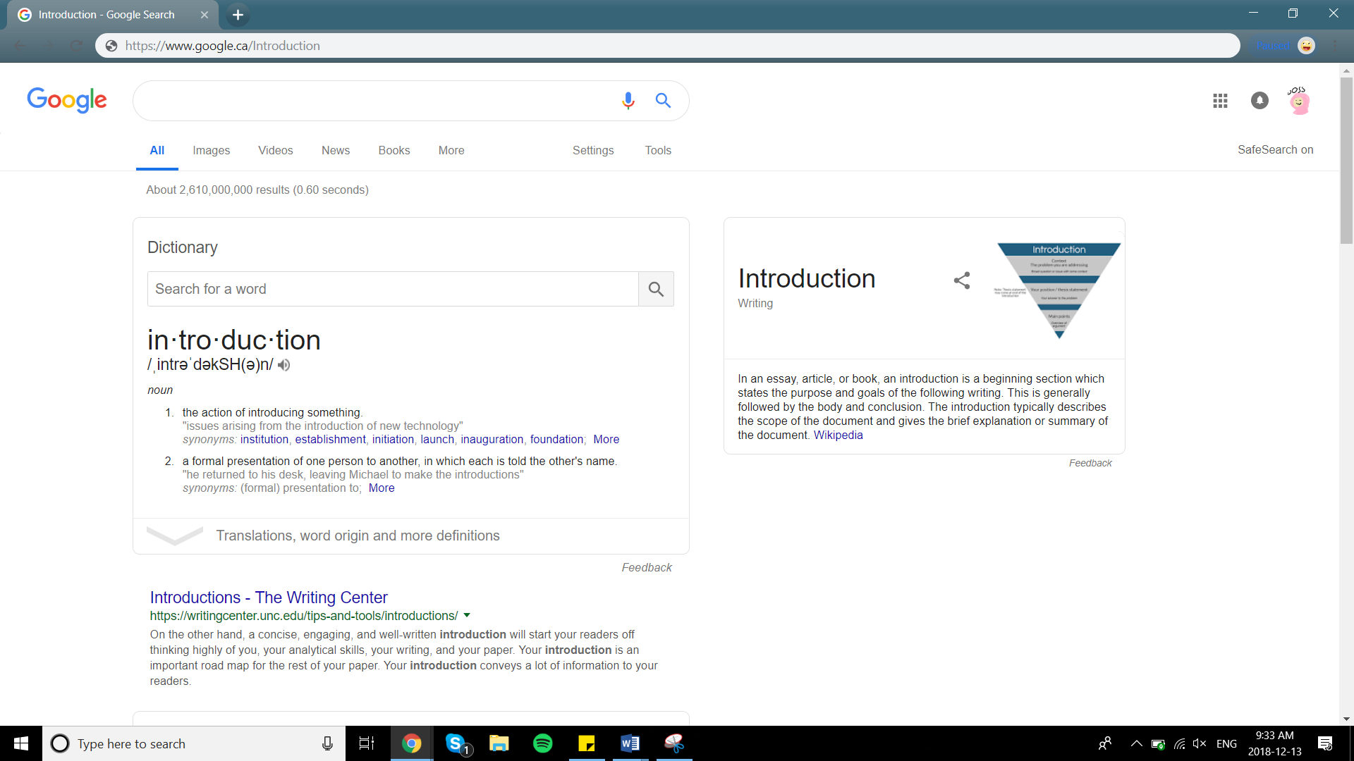
|
Counting Sort

Slide 2


What is Counting Sort
|
It has no comparisons

Slide 3
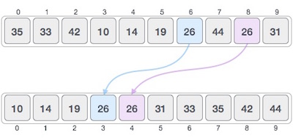
What is Counting Sort
|
It is a stable sorting algorithm

Slide 4
|
What is Counting Sort
O(n+k) time complexity
n = size of array
k = range of numbers
Only bad if k >> n
O(n+k) auxiliary space

Slide 5
|
What is Counting Sort
It is often used as part of other sorts
Allows for better handling of big ranges
Example:
Radix sort

Slide 6
|
What is Counting Sort
How does Counting Sort Work?

Slide 7

How does counting sort work
|
3
1
5
1
2
6
7

Slide 8
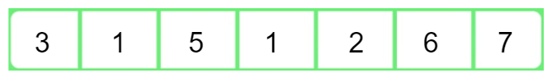
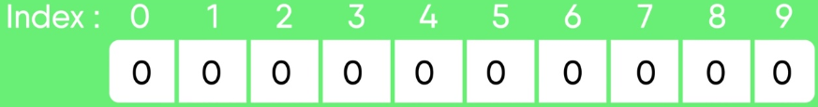
How does counting sort work
|
Count Array:

Slide 9
How does counting sort work
|
Count Array:
1
1
1
1
1
1
2

Slide 10

How does counting sort work
|
Count Array:
1
1
4
4
5
1
1
1
7
2
3
6
1
0+2
2+1
3+1
4+0
Notes:
F

Slide 11
How does counting sort work
|
Original Array:
Count Array:
4
4
4
5
6
1
7
0
2
3
3
6
2
5
Sorted Array:
1
1
2
3
5
6
7

Slide 12
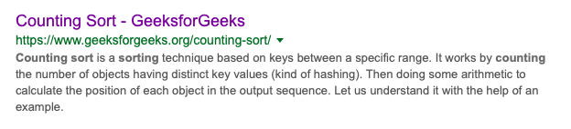
Works Cited
|

